Slide 1






Vue.js
Gangadhar
Naveen
Dristi
Abhishek
Mallikarjun

Slide 2
Overview
Introduction
The Vue Instance
Template Syntax
Computed Properties
Class and Style Bindings
Conditional Rendering
List Rendering
Event Handling
Form Inputs Binding
Components

Slide 3
Introduction
Vue (pronounced /vjuː/, like view) is a progressive framework for building user interfaces.
The core library is focused on the view layer only, and is easy to pick up and integrate with other libraries or existing projects.
Vue is also perfectly capable of powering sophisticated Single-Page Applications when used in combination with modern tooling and supporting libraries.
Vue’s design was partly inspired by MVVM pattern.
Presented by
Gangadhar

Slide 4
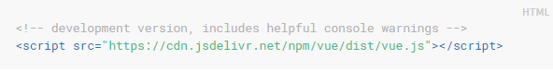
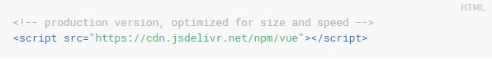
Introduction
CDN link(Content Delivery Network)
Presented by
Gangadhar

Slide 5
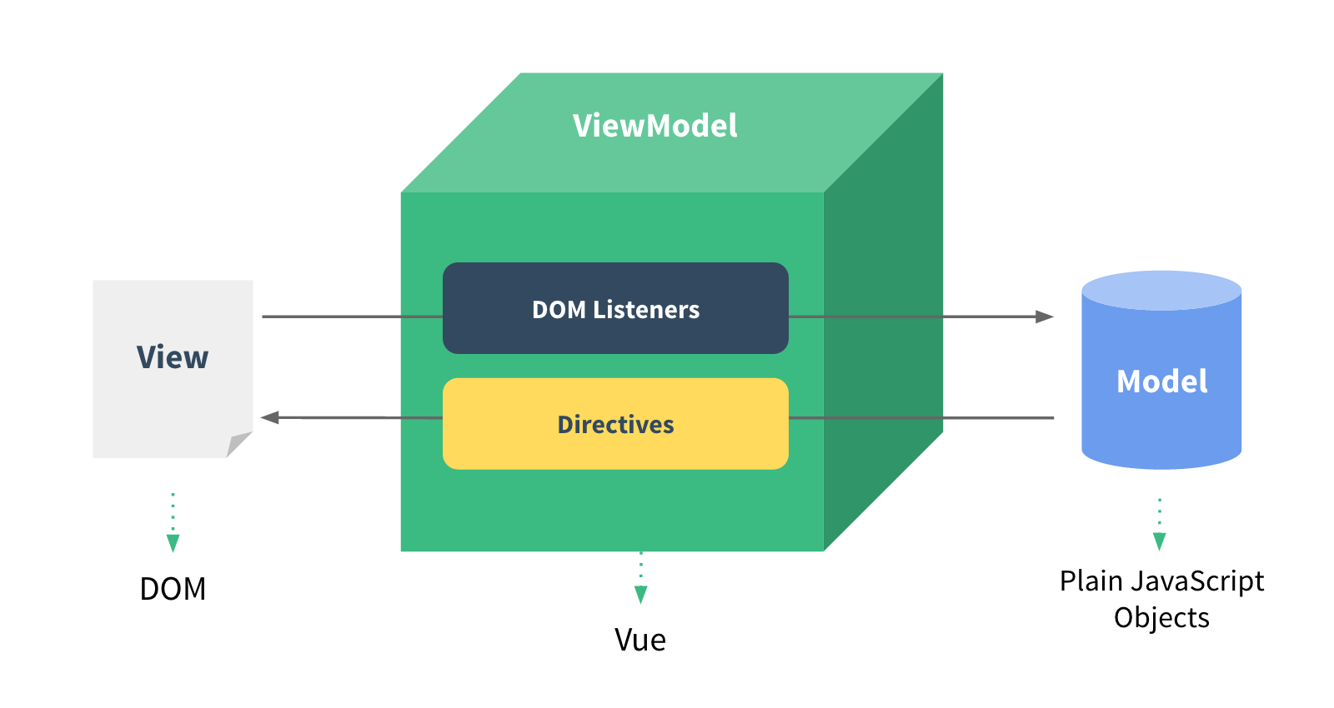
Architecture
Presented by
Gangadhar

Slide 6
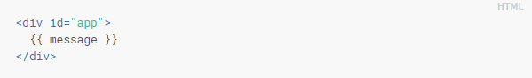
Declarative Binding
At the core of Vue.js is a system that enables us to declaratively render data to the DOM using straightforward template syntax:
Presented by
Gangadhar

Slide 7
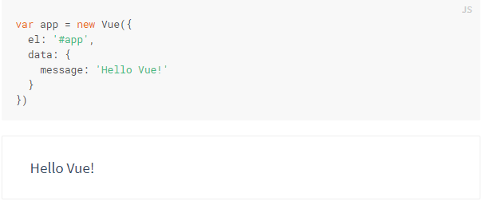
Declarative Binding
Presented by
Gangadhar
The data and the DOM are now linked, and everything is now reactive

Slide 8
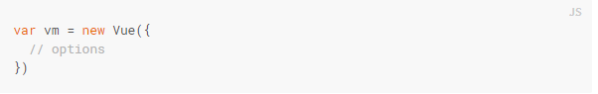
The Vue Instance
Creating a Vue instance
Every Vue application starts by creating a new Vue instance with the Vue function
A Vue application consists of a root Vue instance created with new Vue, optionally organized into a tree of nested, reusable components.
Presented by
Gangadhar

Slide 9
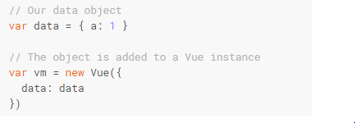
Data and Methods
When a Vue instance is created, it adds all the properties found in data object to Vue’s reactivity system. When the values of those properties change, the view will “react”, updating to match the new values.
Presented by
Gangadhar

Slide 10
Template Syntax
Vue.js uses an HTML-based template syntax that allows you to declaratively bind the rendered DOM to the underlying Vue instance’s data
All Vue.js templates are valid HTML that can be parsed by spec-compliant browsers and HTML parsers
The most basic form of data binding is text interpolation using the “Mustache” syntax (double curly braces):
Presented by
Gangadhar

Slide 11
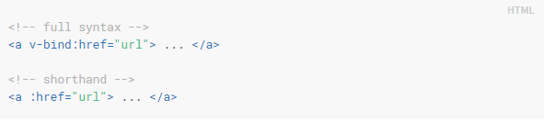
Directives
Directives are special attributes with the v- prefix.
Directive attribute values are expected to be a single JavaScript expression.
A directive’s job is to reactively apply side effects to the DOM when the value of its expression changes.
Presented by
Gangadhar

Slide 12
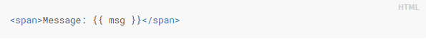
Interpolations
The mustache tag will be replaced with the value of the msg property on the corresponding data object. It will also be updated whenever the data object’s msg
Attributes
Mustaches cannot be used inside HTML attributes. Instead, use a v-bind directive
Presented by
Gangadhar

Slide 13
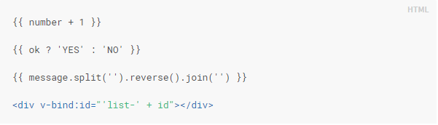
Using JavaScript Expressions
Vue.js supports the full power of JavaScript expressions inside all data bindings
These expressions will be evaluated as JavaScript in the data scope of the owner Vue instance. One restriction is that each binding can only contain one single expression
Presented by
Gangadhar

Slide 14
Computed Properties
Valuable for maintaining data that already exists.
Defined in the computed property of VUE Component
Cached based on their dependencies and will only update when needed
<script> export default { computed: { } } </script>
Presented by
Dristi

Slide 15
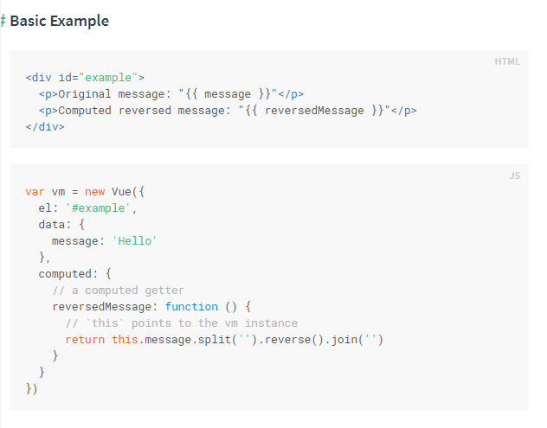
Basic Example
Presented by
Dristi

Slide 16
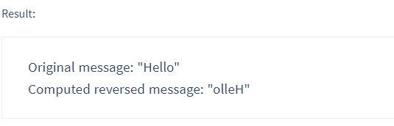
RESULT
Presented by
Dristi

Slide 17
Class and style binding
Need of data binding to manipulate an element’s class list and its inline styles
V-bind used with class and style
Class Binding Example:
An object passed to v-bind : class to dynamically toggle classes
<div class="static" v-bind :class ="{ 'class-a': isA, 'class-b': isB }"></div>
data: {
isA : true,
isB : false
}
It will render <div class="static class-a"></div>
Presented by
Dristi

Slide 18
CONTINUE..
An array passed to v-bind : class to apply list of classes
<div v-bind : class = “[activeClass , errorClass]”></div>
data : {
activeClass : ‘active’,
errorClass: ‘text-danger’
}
Renders <div class= “active text-danger”></div>
Presented by
Dristi

Slide 19
CONTINUE..
Style Binding Example:
Almost looks like CSS but a JavaScript object
<div v-bind : style = “{ color :activeColor , fontSize : fontSize + ‘px’}”></div>
data:{
activeColor : ‘red’ ,
fontSize : 30
}
Presented by
Dristi

Slide 20
Conditional Rendering
v-if
V-else
V-else-if
v-if vs v-show
v-if with v-for
Presented by
Mallikarjuna

Slide 21
Conditional Rendering
In string templates , for example Handlebars we would write conditional block like :
{{#if ok}}
<h1>yes</h1>
{{/if}}
What in Vue.js???
Presented by
Mallikarjuna

Slide 22
Conditional Rendering
<h1 v-if="ok">Yes</h1>
It is also possible to add an “else block” with v-else:
<h1 v-if="ok">Yes</h1>
<h1 v-else>No</h1>
If we want to toggle more than one element???
<template v-if=“ok”>
<h1>Title</h1>
<p>paragraph</p>
</template>
Presented by
Mallikarjuna

Slide 23
Conditional Rendering v-else-if
As the name suggests ,it serves as “else if block ”for the v-if.
<div v –if=“type ===‘A’”>
Northwest
</div>
<div v-else-if=“type===‘B’”>
Bearcat
</div>
<div v-else>
Northwest Missouri State University
</div>
Note: it can be chained multiple times.
Presented by
Mallikarjuna

Slide 24
Conditional Rendering v-if vs v-show
<h1 v-show=“ok”>HelloWorld</h1>
V –show does not support <template>element, nor does it work
With v-else.
v-if with v-for
When exist together v-for has highest priority than the v-if.
Presented by
Mallikarjuna

Slide 25
List Rendering
<ul id="example-1"> <li v-for="item in items"> {{ item.message }} </li> </ul>
Var eample1 = new Vue({
e1: ‘#example-1’,
Data:{
Items:[
{message:’Hii’ },
{message:’hello’},
]
}
})
Presented by
Mallikarjuna

Slide 26
Event Handlers
WHAT IS EVENT HANDLERS?
An event handler typically is a software routine that processes actions such as keystrokes and mouse movements. With Web sites, event handlers make Web content dynamic. JavaScript is a common method of scripting event handlers for Web content
LISTENING TO EVENTS
METHODS EVENT HANDLERS
EVENT MODIFIERS
KEY MODIFIERS
Presented by
Naveen

Slide 27
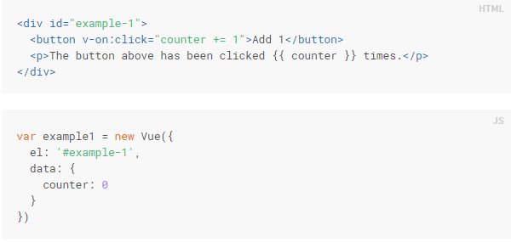
LISTENING TO EVENTS
We can use the V-ON directive to listen to DOM events and run some JavaScript when they’re triggered.
For example:
Presented by
Naveen

Slide 28
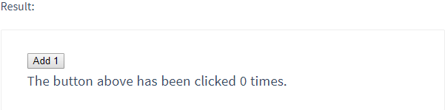
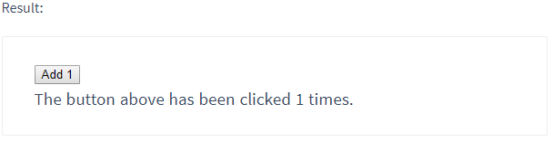
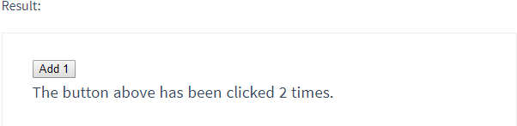
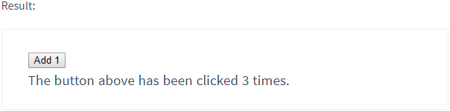
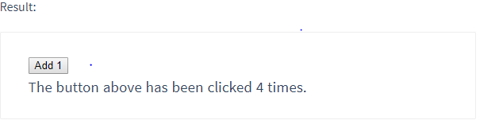
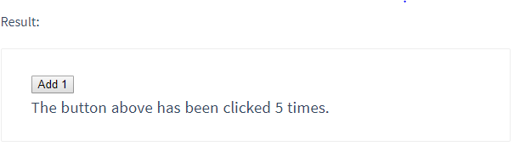
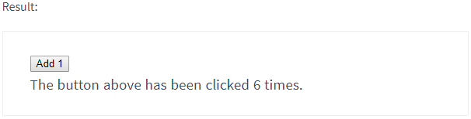

Presented by
Naveen

Slide 29
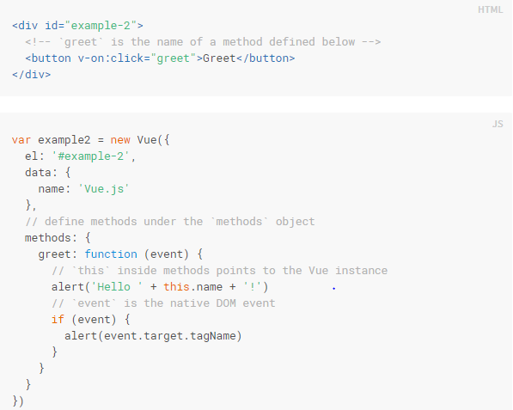
METHOD EVENT HANDLERS
The logic for many event handlers will be more complex though, so keeping your JavaScript in the value of the v-on attribute isn’t feasible. That’s why v-on can also accept the name of a method you’d like to call.
Presented by
Naveen

Slide 30

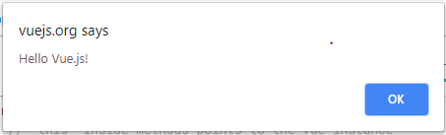
Presented by
Naveen

Slide 31
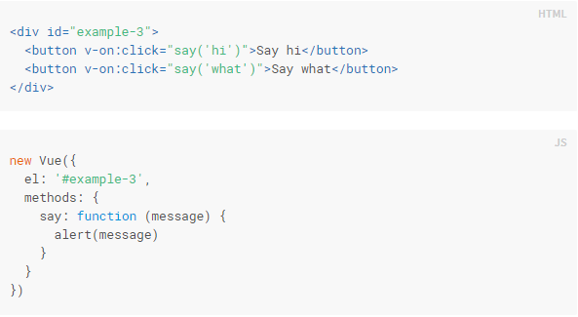
Methods in Inline Handlers
Instead of binding directly to a method name, we can also use methods in an inline JavaScript statement:
Presented by
Naveen

Slide 32
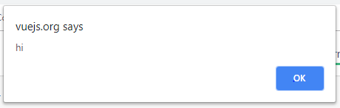

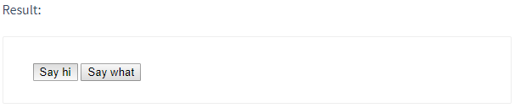
Presented by
Naveen

Slide 33
Event Modifiers
It is a very common need to call event.preventDefault( ) or event.stopProgation(). inside event handlers. Although we can do this easily inside methods, it would be better if the methods can be purely about data logic rather than having to deal with DOM event details.
.stop
.prevent
.capture
.self
.once
.passive
Presented by
Naveen

Slide 34
Key Modifiers
When listening for keyboard events, we often need to check for common key codes. Vue also allows adding key modifiers for v-on when listening for key events:
.enter
.tab
.delete
.esc
.space
.up
.down
.left
.right
Presented by
Naveen

Slide 35
Form Input Bindings
You can use the v-mode1 directive to create two-way data bindings on form input, textarea, and select elements. It automatically picks the correct way to update the element based on the input type. Although a bit magical, v-node is essentially syntax sugar for updating data on user input events, plus special care for some edge cases.
Text
Multiline text
Checkbox
Radio
Select
Checkbox
Select option
Presented by
Naveen

Slide 36
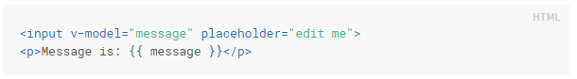
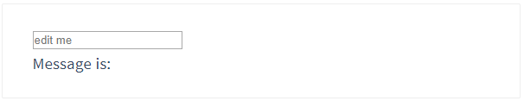
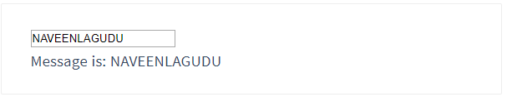
TEXT
Presented by
Naveen

Slide 37
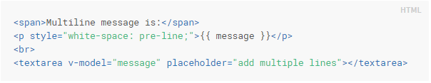
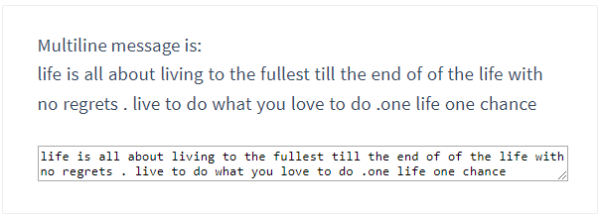
Multiple Line Text
Presented by
Naveen

Slide 38
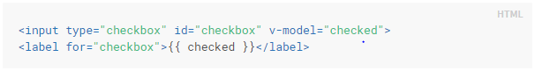
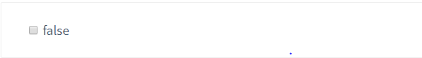

CheckBox
Single checkbox, boolean value:
Result:
Presented by
Naveen

Slide 39
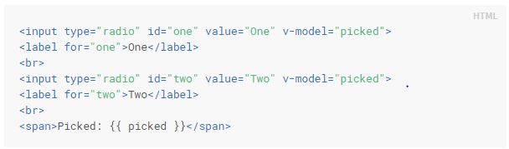
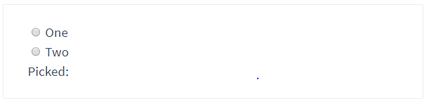
Radio
Presented by
Naveen

Slide 40
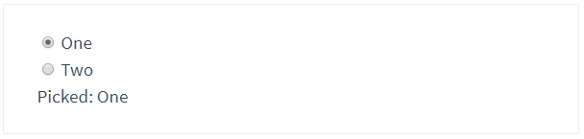
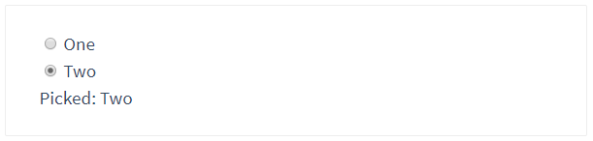
Presented by
Naveen

Slide 41
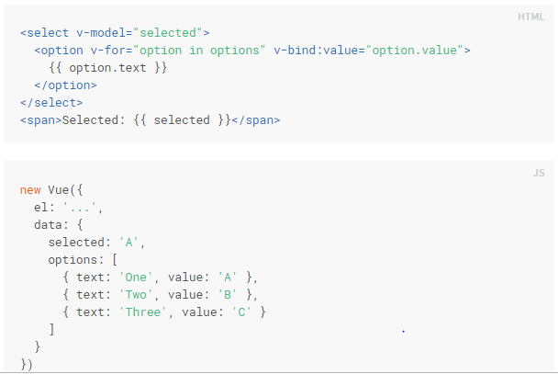
Select
Presented by
Naveen

Slide 42
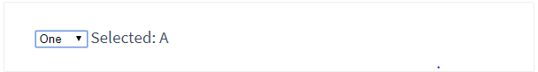
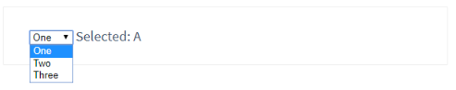
Result
Presented by
Naveen

Slide 43
Components Basic
Components are reusable piece of code that can be used in different Vue instances
Can be used as a custom element inside a root Vue instance
How can we Create the component?
Syntax:
(Method name) Vue.component(‘string’,{object(property)});
Presented by
Abhishek

Slide 44
Component Example
Vue.component(‘greeting’,{
template: ‘<p> Hey there, I am a reusable source! Don’t waste your energy to create new template!</p>
});
Vue instances:
new Vue({el:’#vue-app-one’});
new Vue({el:’#vue-app-two’});
Presented by
Abhishek

Slide 45
Components in Action
< div id = “vue-app-one”>
<h2> vue-app-one </h2>
<greeting></greeting>
</div>
< div id = “vue-app-two”>
<h2> vue-app-one </h2>
<greeting></greeting>
</div>
Presented by
Abhishek

Slide 46
Can data be a paramente
Yes, but it has to be a function!
Vue.component(‘greeting’,{
tremplate:’<p>{{notice}}, <button v-on click =“”>Change Notice </button></p>,
data: function(){
return {
notice : ‘Hey there, I am a reusable source! Don’t waste your energy to create new template!’
}},
methods:{
changeNotice : function(){
this.notice = ‘Congratulation’ you are an awesome Hoo-man!’;
}}
});
Presented by
Abhishek

Slide 47
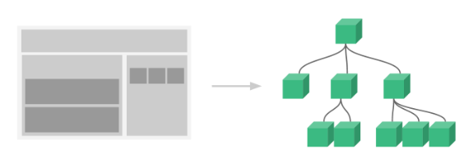
Organizing Components
Common for an app to be organized into a tree of nested components
For example : components for a header, sidebar, and content area, each typically containing other components for navigation links can be created
To use these components in templates, they must be registered
Global registration: (available to all sub components)
Vue.component(….);
Local registration: (only use it when necessary)
Define as plain JavaScript objects:
var ComponentA = { /* ... */ }
var ComponentB = { /* ... */ }
Presented by
Abhishek

Slide 48
Passing Data to Child Components with Props
Props are custom attributes you can register on a component
Vue.component('blog-post', {
props: ['title'],
template: '<h3>{{ title }}</h3>'
});
A component can have as many props as, any value can be passed to any prop
Presented by
Abhishek

Slide 49
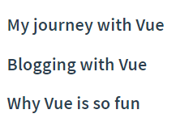
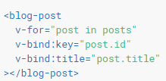
Passing data…(continues)
Once a prop is registered, data can be passed as a custom attribute, like this:
<blog-post title="My journey with Vue"></blog-post>
<blog-post title="Blogging with Vue"></blog-post>
<blog-post title="Why Vue is so fun"></blog-post>
Array of Post data:
new Vue({ el: '#blog-post-demo', Then want to render a component for each one:
data: {
posts: [
{ id: 1, title: 'My journey with Vue' },
{ id: 2, title: 'Blogging with Vue' },
{ id: 3, title: 'Why Vue is so fun' } ] } })
Presented by
Abhishek

Slide 50
Root Element
When building a component with multiple properties:
<h3>{{ title }}</h3>
<div v-html="content"></div>
Error: every component must have a single root element
Solution: Wrap the properties in root (prent) element
<div class="blog-post">
<h3>{{ title }}</h3>
<div v-html="content"></div>
</div>
Presented by
Abhishek

Slide 51
Sending Messages to Parents with Events
Changes can be made in the parent component through the child component using events.
Example: To enlarge a text in a component:
In child: (emit the change) In parent: (Listen)
<button v-on:click="$emit('enlarge-text', 0.1)"> <blog-post
Enlarge text v-on:enlarge-text="postFontSize += $event"
</button> ></blog-post>
Presented by
Abhishek

Slide 52
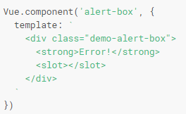
Content Distribution with Slots
it’s often useful to be able to pass content to a component.
This task can be achieved using <slot> element.
Presented by
Abhishek

Slide 53
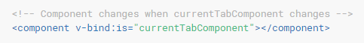
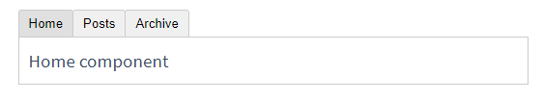
Dynamic Components
Vue’s <component> element with the is special attribute (allowing us to use tabbed components):
In the example above, currentTabComponent can contain either:
the name of a registered component, or
a component’s options object
Presented by
Abhishek

Slide 54
DOM Template Parsing Caveats
DOM Templates are defined inside an actual .html file that the browser will load and open. Those are usually used when we don’t use a build system and directly include Vue in the page.
For example:
<body>
<div id="app"> <!-- your App is runnning in this div --->
<my-component></my-component>
</div>
<template id="template-for-my-component">
{{ message }}
</template>
</body>
This HTML will be controlled by the browser before Vue can work with it, and therefore Vue is limited by the caveats explained in the linked documentation (can’t use other elments besides <tr>,<tbody> in <table> etc.).
Presented by
Abhishek

